Slide 1
NMap Network Mapping Tool
Brayden Faulkner

Slide 2
What is NMap?
An open source networking mapping tool
Used to discover and provide information about host machines
Information could includes things such as telling us which OS a system is running, what kind of services the host is running, and what ports are open on a host machine

Slide 3
Port Scanning
The most basic functionality NMap is a port scanner, or software that allows us to discover what ports are open on a given machine
Works by sending specified packets to a host and analyzing the responses received
EX: Sending a SYN packet to 192.168.56.1 at port 22 and seeing if it recieves a SYN/ACK packet
Can conduct a number of different types of port scans such as SYN, TCP, UDP, NULL, and XMAS scans
Ports can be labeled as Open, Closed, or Filtered in these scans
Not all scans can tell you exactly what a port is, EX: A UDP scan might say that a port is Open/Filtered meaning it knows it is one of the two, but its not sure which

Slide 4
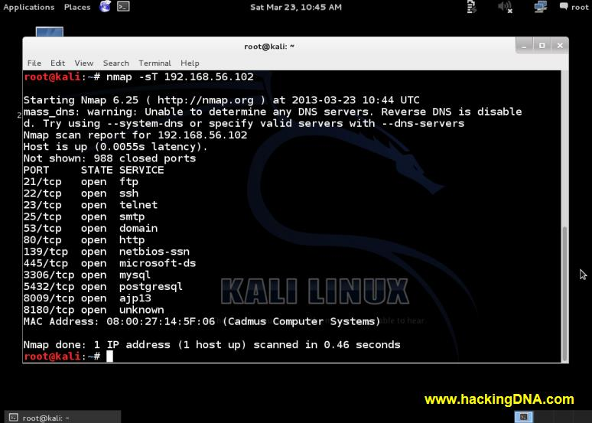
TCP Scan Example

Slide 5
Service Detection
One of NMap’s more advanced features allows us to determine the exact Service and Version that a host is running
Works by sending various packets to determine various factors about a service, such as what type of network protocol it uses and how it responds to certain queries
This process is known as fingerprinting
Then compares these results to a fingerprint database

Slide 6
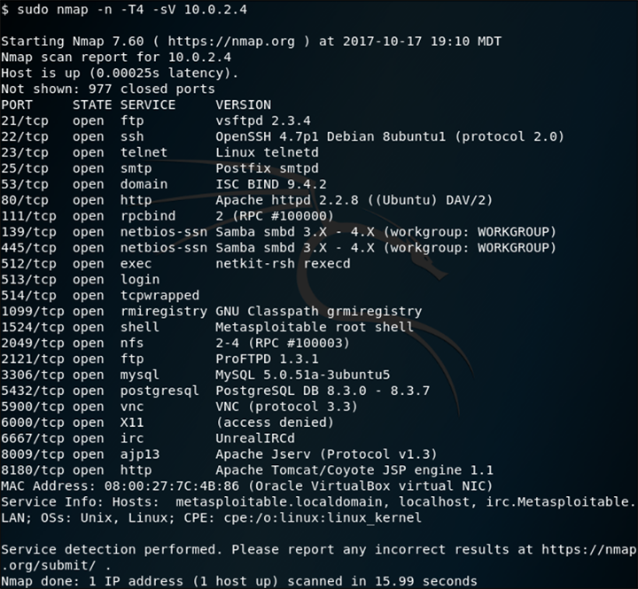
Version Scan Example

Slide 7
NMap Scripting Engine
Hands down the most useful and powerful feature provided by NMap is its scripting engine
Allows anyone to write scripts that automate scans and other networking tasks
Scripts are written in Lua
Service, OS, and Vulnerability detection are all accomplished through pre-made scripts

Slide 8
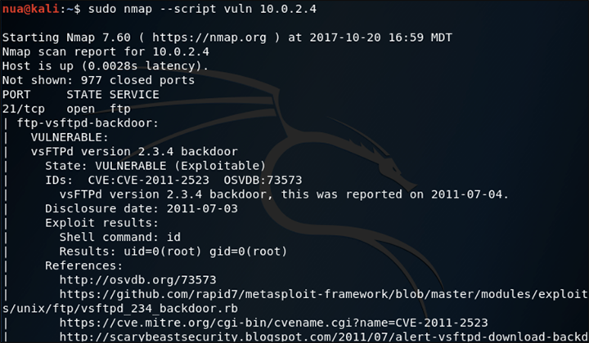
Script Example

Slide 9
References
Source and Guide:
https://nmap.org/

